Slide 1

Telecommunication Customer Churn

Slide 2
About Me
Background
Batchelor of Engineering (Mechanical)
Work Experience
ICICI Bank - Hyderabad (1 Year)
Wipro Limited - Hyderabad (3 Years)
Resource Pro Pvt - Bangalore (2 Year)
Name
Anwar Basha

Slide 3
Introduction
The telecommunications sector in developed countries faces intense competition due to technical advancements and an increasing number of operators, necessitating innovative strategies for survival.
Three main strategies have been proposed to generate more revenues:
1. Acquire new customers
2. Upsell the existing customers
3. Increase the retention period of customers
Increasing the retention period of existing customers has been found to be the most profitable and cost effective.
Customer churn, defined as the movement of customers from one provider to another.
Predicting customer churn early presents an opportunity for companies to mitigate potential revenue loss and capitalize on additional revenue sources.

Slide 4
Objective of Churn Prediction
Increase Customer Retention
Enhance Customer Satisfaction
Improve Revenue Forecasting
Identifying Churn Indicators

Slide 5
Dataset Analysis
The dataset utilized for this project comprises 7043 observations and 21 features
Customer Account Information
Tenure
Contract
Demographic Info
Gender
Services
Phone
Age
Partners
Dependents
Total Charges
Monthly Charges
Paperless Billing
Payment Method
Streaming TV
Tech Support
Device Protection
Online Backup
Online Security
Internet
Multiple Lines
Customer ID
Senior Citizens
Streaming Movies

Slide 6
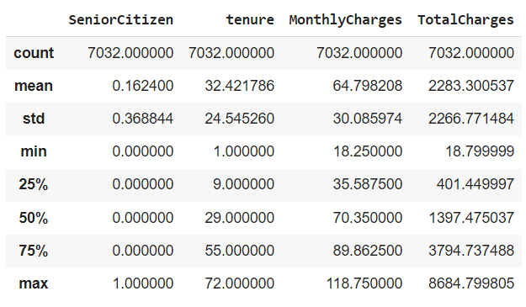
Statistical Analysis of Numerical Features

Slide 7
Exploratory Data Analysis

Slide 8
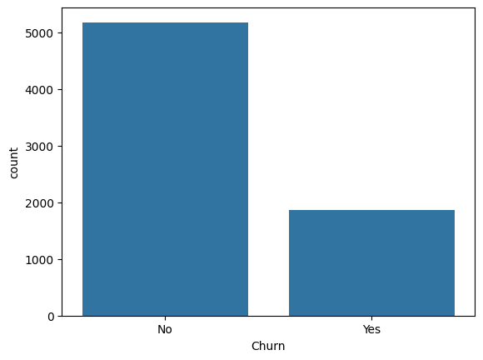
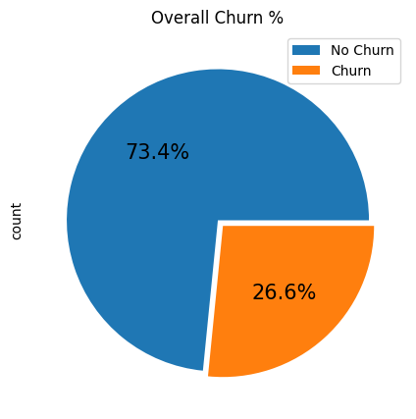
Churn Analysis

Slide 9
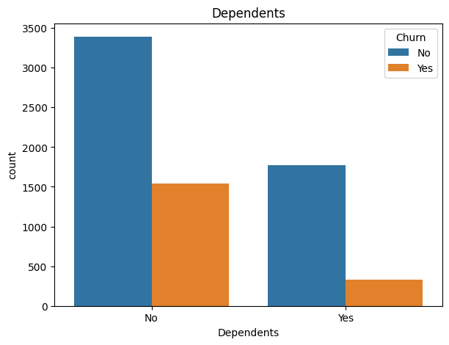
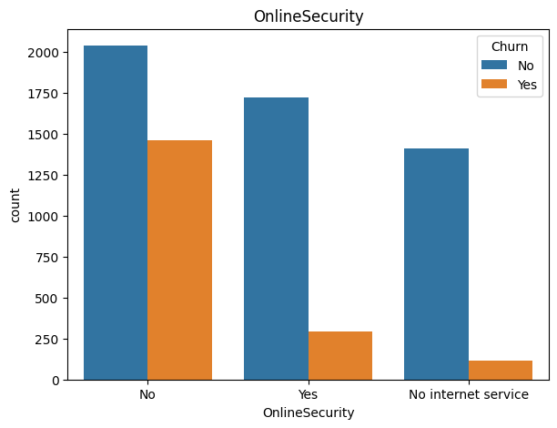
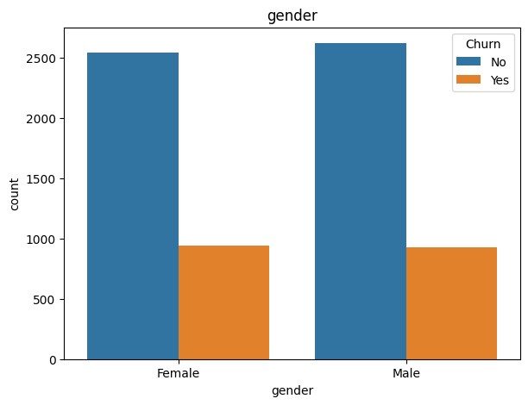
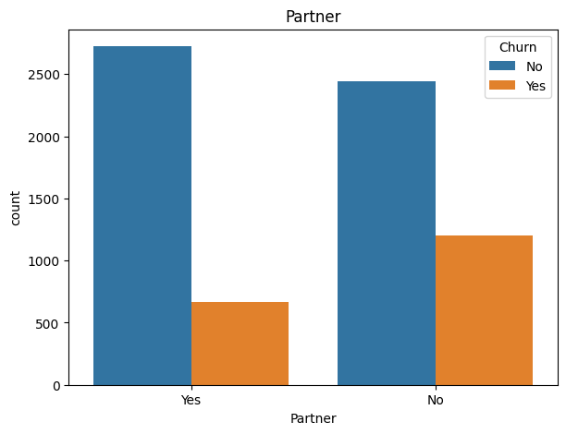
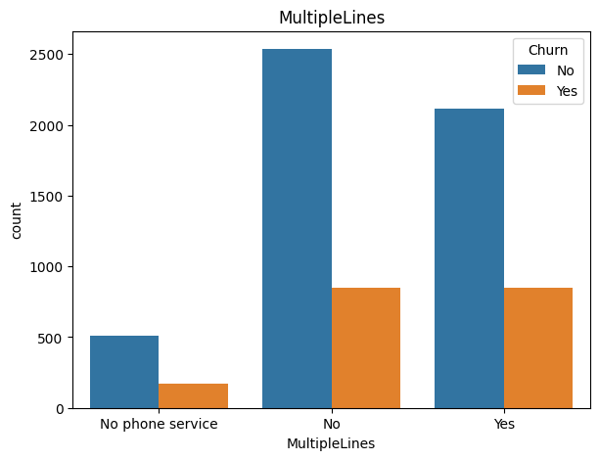
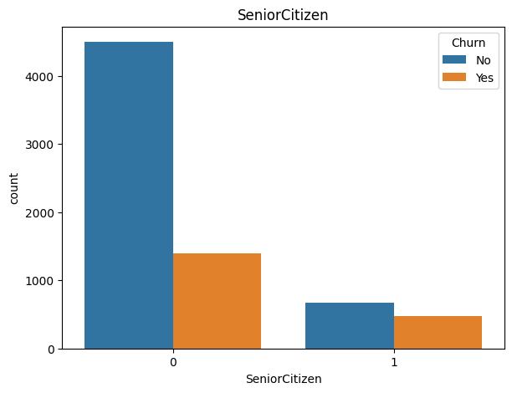
Categorical Features Analysis

Slide 10
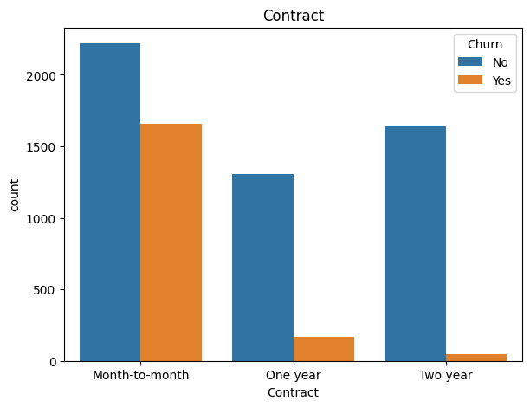
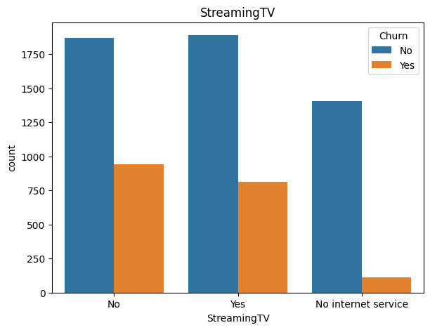
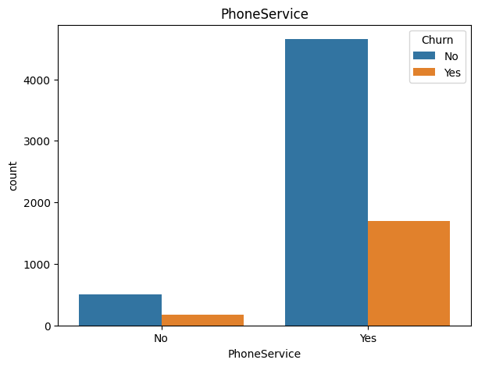
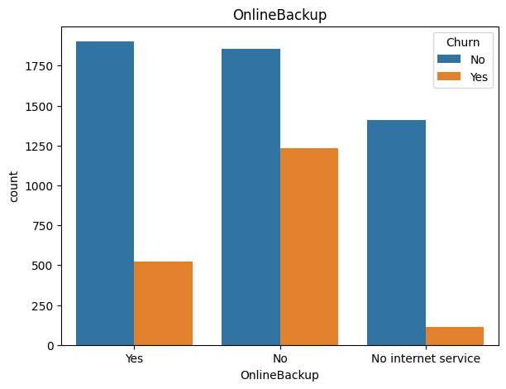

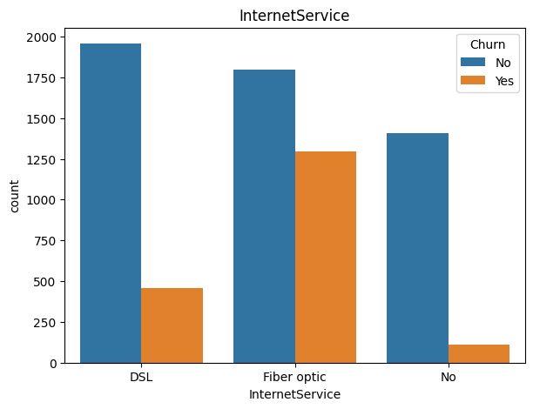
Categorical Features Analysis

Slide 11
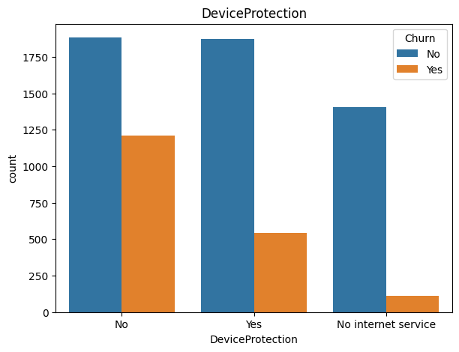
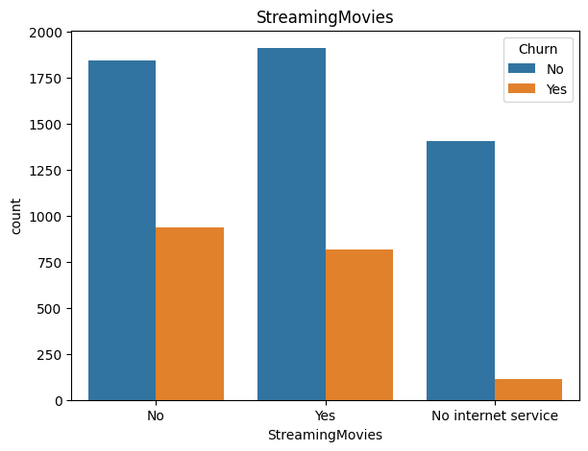
Categorical Features Analysis

Slide 12
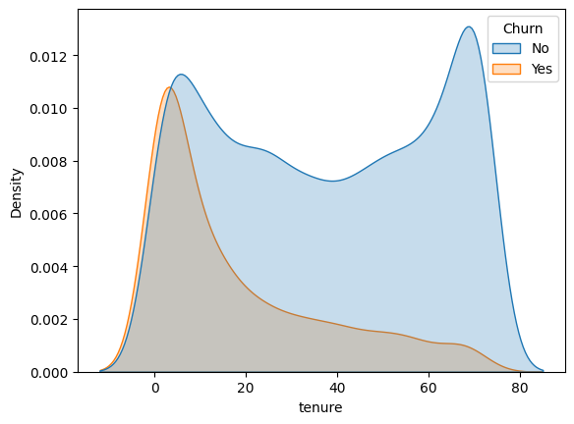
Numerical Features Analysis - Tenure

Slide 13
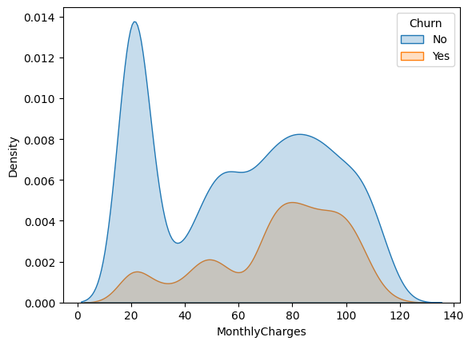
Numerical Features Analysis – Monthly Charges

Slide 14
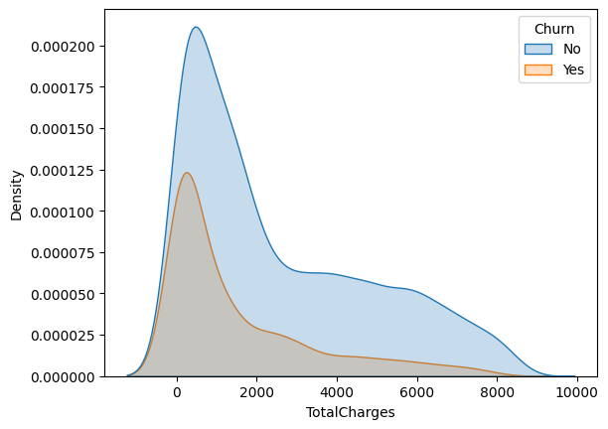
Numerical Features Analysis – Total Charges

Slide 15
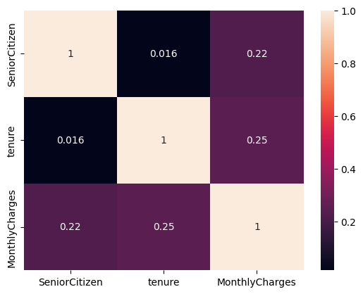
Co-Relation Heatmap for Numerical Features

Slide 16
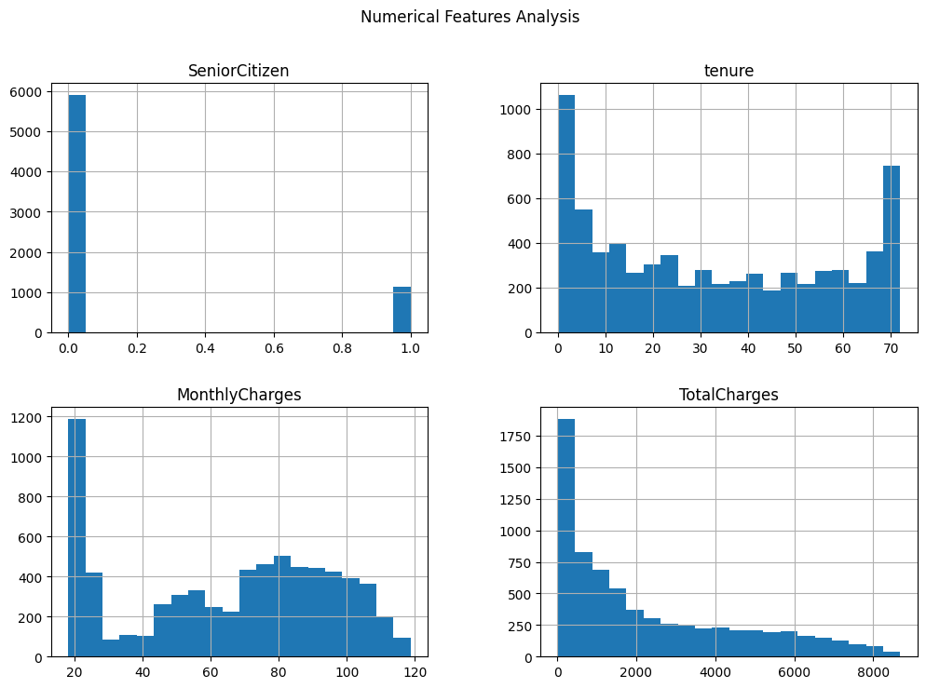

Slide 17
Machine Learning - Model Training

Slide 18
Methodology
Data Splitting
Preprocessing
Convert categorical into numerical
Model Training
Employing various algorithms for model training
Testing Data (25%)
Scaling numerical values
Evaluation
Evaluating trained models utilizing diverse metrics
Identify Target Variable
Training Data (75%)

Slide 19
Data Splitting
Partitioning the data into training (75%) and testing (25%) sets using the train-test split method
Identifying the target variable within the dataset and subsequently segregating it from the dataset for model training purposes. This variable is withheld for analyzing model performance.
The training dataset comprises 5282 observations across 19 columns, while the testing dataset consists of 1761 observations with a single column

Slide 20
Data Set
(7043*21)
Training Data
(5282*19)
Testing Data
(1761*19)
Categorical Training Data
Numerical Training Data
Categorical Testing Data
Numerical Testing data
Encoding
Scaling
Encoding
Scaling
Final Training Data
Final Testing Data

Slide 21
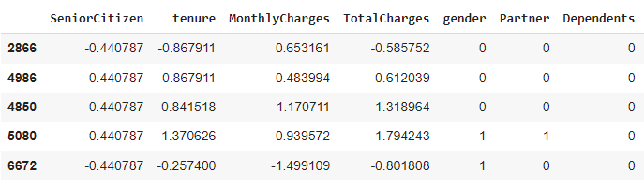
Data Preprocessing
Transforming categorical data into numerical values via Label Encoder
Enhancing model performance by scaling numerical features using Standard Scale
An overview of the training dataset after preprocessing reveals..

Slide 22
Model Training and Evaluation
Types of Algorithm
KNN
Evaluation Methods
Data with predicted Missing Values
Linear Regression
Support Vector Machine
Decision Tree
Random Forest
Data without missing values
Hyperparameters Tuning

Slide 23
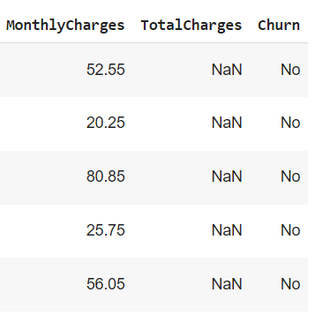
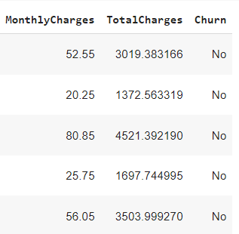
Predicting Missing Values – Linear Regression
Before Prediction
After Prediction

Slide 24
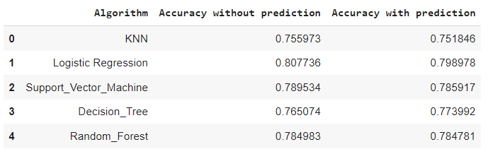
Performance Analysis

Slide 25
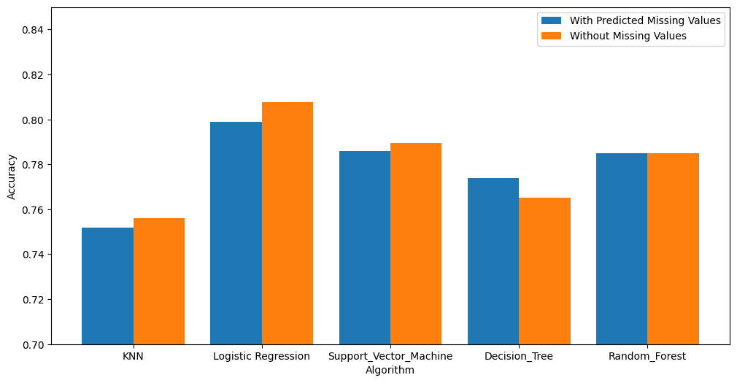
Accuracy Analysis

Slide 26
Hyperparameters Tuning

Slide 27
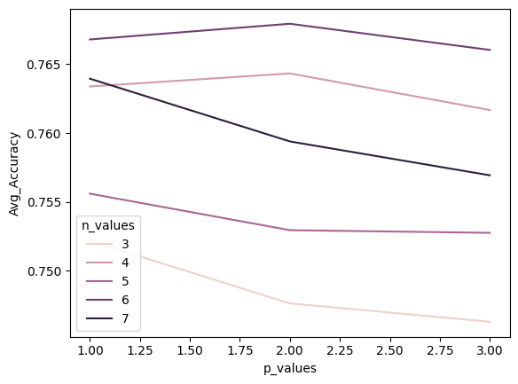
Hyperparameter Tuning - KNN

Slide 28
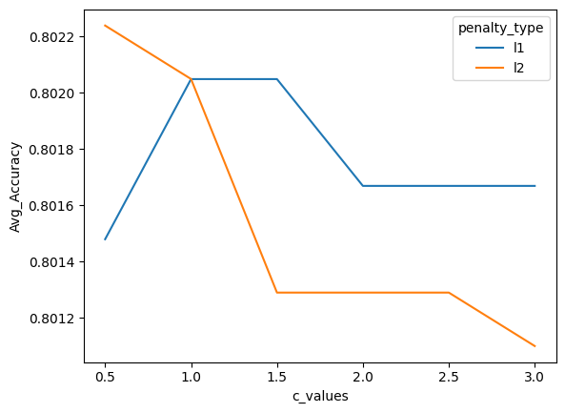
Hyperparameter Tuning – Logistic Regression

Slide 29
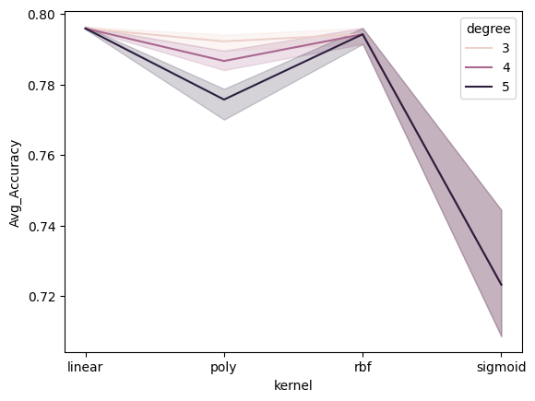
Hyperparameter Tuning – Support Vector Machine

Slide 30
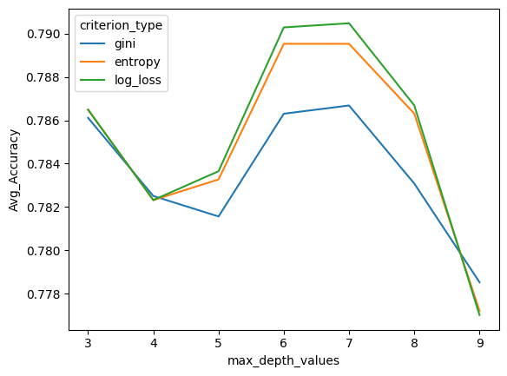
Hyperparameter Tuning – Decision Tree

Slide 31
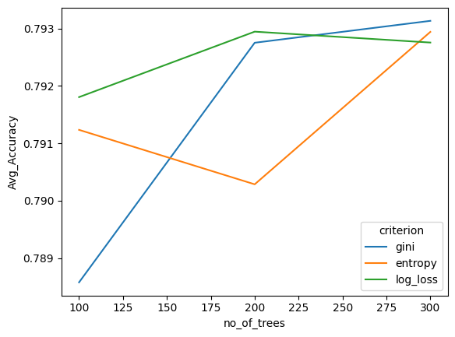
Hyperparameter Tuning – Random Forest

Slide 32
Model Evaluation

Slide 33
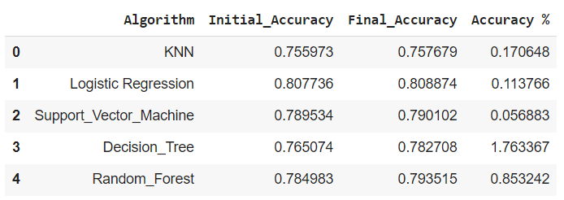
Accuracy after Hyperparameter Tuning

Slide 34
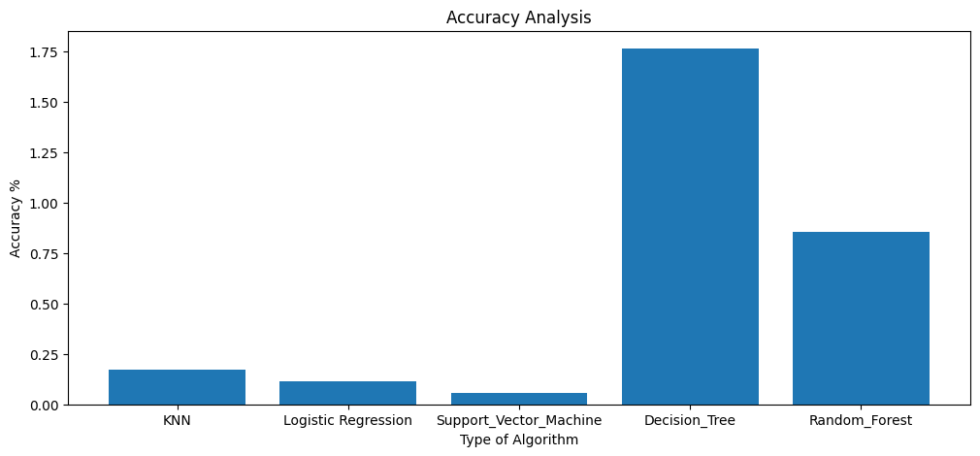
Hyperparameter Tuning Performance

Slide 35
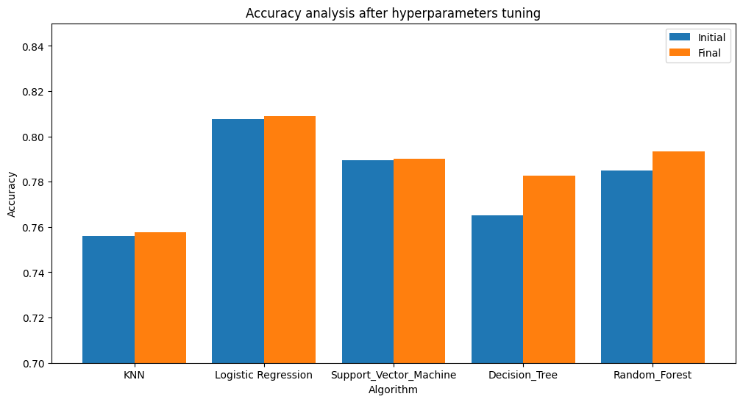

Slide 36
Conclusion
The Logistic Regression model emerges as the top performer among all algorithms utilized in the analysis, showcasing superior predictive capabilities.
Evaluation based on Accuracy scores after hyperparameters tuning indicates that the Logistic Regression achieves an impressive predictive accuracy of approximately 81%, underscoring its effectiveness in forecasting Churn.

Slide 37
Q & A

Slide 38

THANK YOU

